Slide 1
Detecting Concept Drift with Support Vector Machines
~ Ralf Klinkenberg & Thorsten Joachims (2000)

Slide 2
What the paper is about
A new method to recognize and handle concept changes.
Key idea is to automatically adjust the window size so that the estimated generalization error is minimized.
This paper explains the new window adjustment approach and evaluates it in three simulated concept drift scenarios on real-world text data.
The window adjustment approach described in this paper uses support vector machines (Vapnik, 1998) as their core learning algorithm.
The approach has a clear theoretical motivation and does not require complicated parameter tuning.
The adaptive window size algorithm can achieve a relatively low error rate over all phases in all scenarios of concept drift.

Slide 3
Previous Models
Helmbold, & Long (1994) assume a possibly permanent but slow concept drift and define the extent of drift as the probability that two subsequent concepts disagree on a randomly drawn example.
While Helmbold and Long (1991) restrict the extend of drift, determine a maximal rate of drift that is acceptable by any learner.
Widmer & Kubat, 1996; Lanquillon, 1997 and Klinkenberg & Renz, 1998 also developed models to handle concept drift and produce minimal error during the prediction. While these heuristics are intuitive and work well in their particular application domain, they usually require tuning their parameters, are often not transferable to other domains, and lack a proper theoretical foundation.

Slide 4
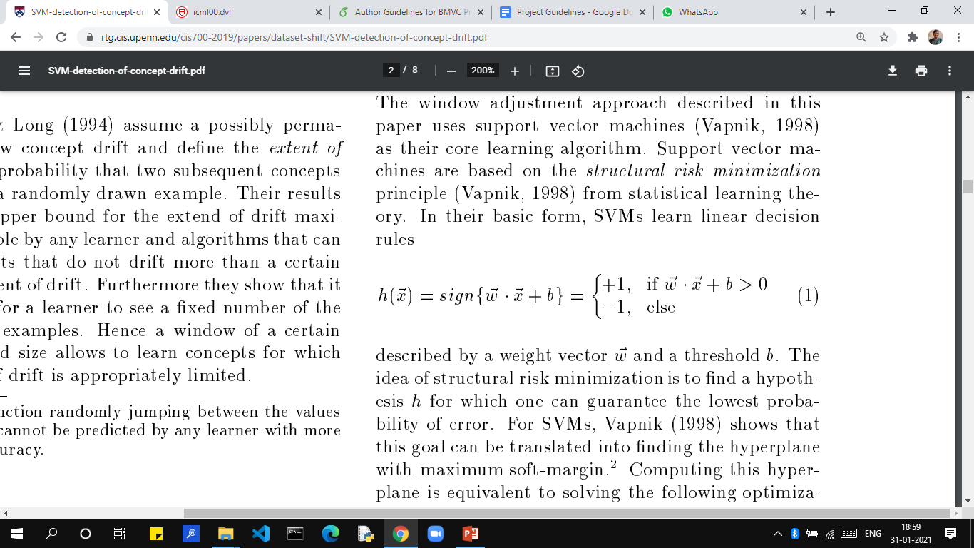
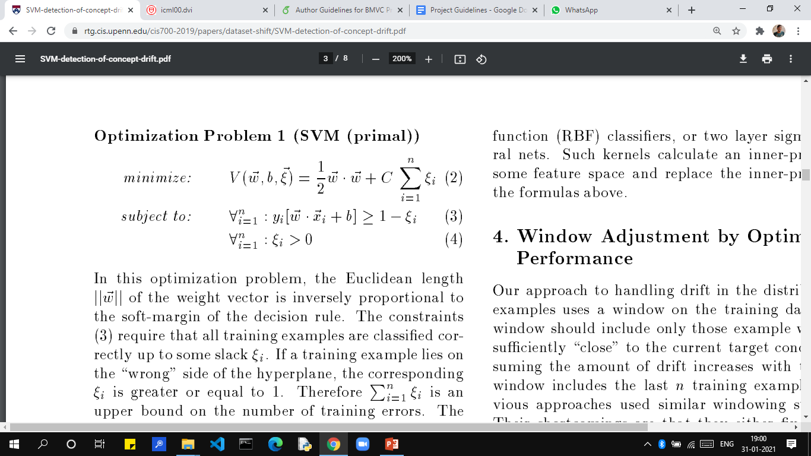
Technicalities
In their basic form, SVMs learn linear decision rules described by a weight vector w vector and a threshold b.
The constraints (3) require that all training examples are classified correctly up to some slack ksaai.

Slide 5
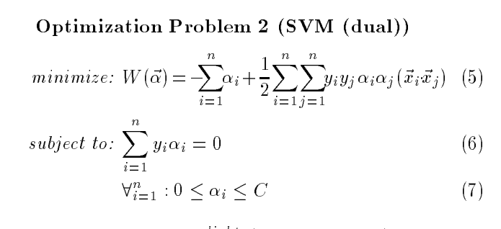
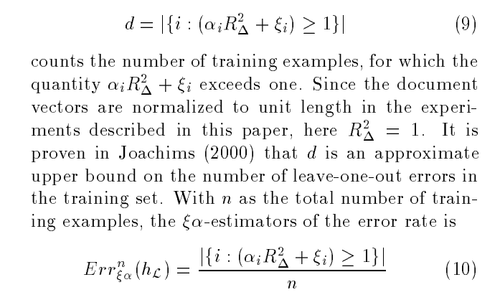
Support vectors are those training examples with alpha > 0 at the solution
Ksaai is the vector of training losses at the solution of the primal SVM training problem. Alpha is the solution of the dual SVM training problem. Based on these two vectors, both are available after training the SVM at no extra cost. The ksaai alpha estimators are defined using the following two counts.

Slide 6
The Algorithm
At batch t, it essentially tries various window sizes, training a SVM for each:
Only from the last batch i.e. t
Last batch t and last to last batch t-1 both
Similarly in each step it adds one more batch till all batches are covered
For each window size it computes ksaai alpha estimate based on the result of training.
The ksaai alpha estimator used here considers only the last batch, t, that is the m most recent training examples.
This reflects the assumption that the most recent examples are most similar to the new examples in the next batch i.e. t+1.
Now the most successful model of all of them is chosen to predict the label of next batch.

Slide 7
The Experiment
The experiments use a subset of 2600 documents of the data set of TREC consisting of English text. The texts are randomly split into 20 batches of equal size containing 130 documents each. Each text is assigned some categories from 1 to 6. To perform the actual experiment, we will take four data management approaches:
Full memory
No memory
Window of fixed size
Window of adaptive size.
It involves three different scenario of concept drift.
In scenario A, first documents of category 1 are considered relevant. This changes abruptly in batch 10, where documents of category 3 becomes relevant.
In scenario B, first documents of category 1 are considered relevant. This changes slowly (concept drift) from batch 8 to batch 12,where documents of category 3 are relevant.
In the scenario C, there is an abrupt concept shift from category 1to category 3 in batch 9 and back to category 1 in batch 11.

Slide 8
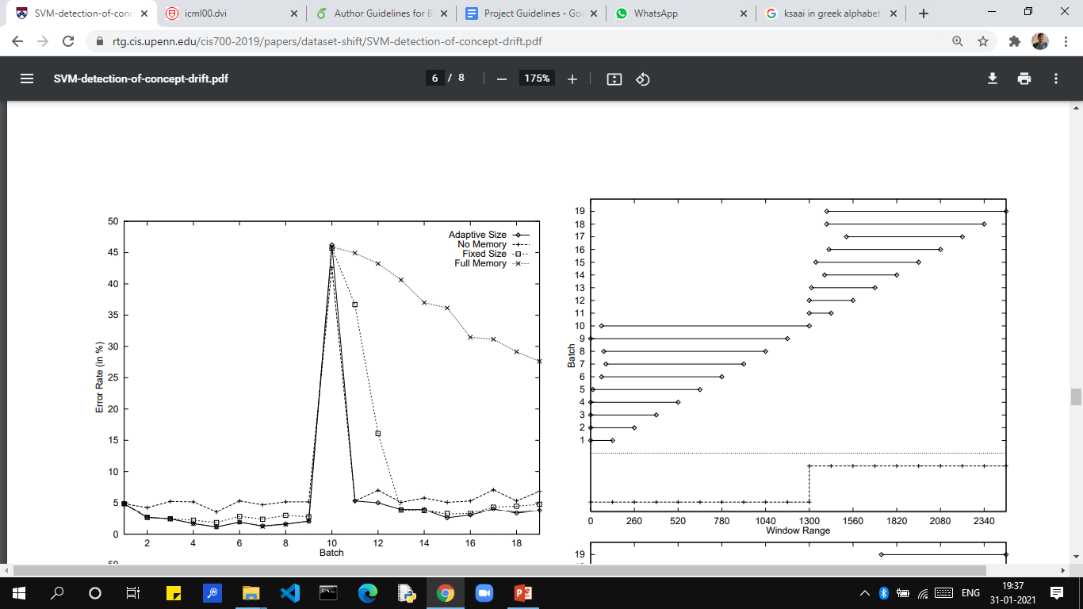
The Result

Slide 9
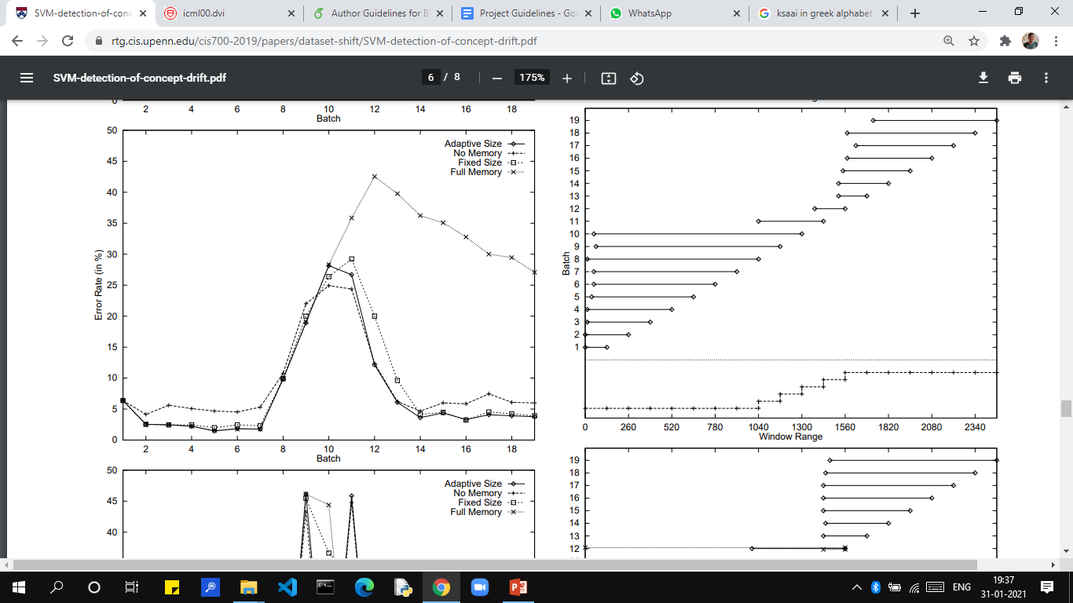

Slide 10
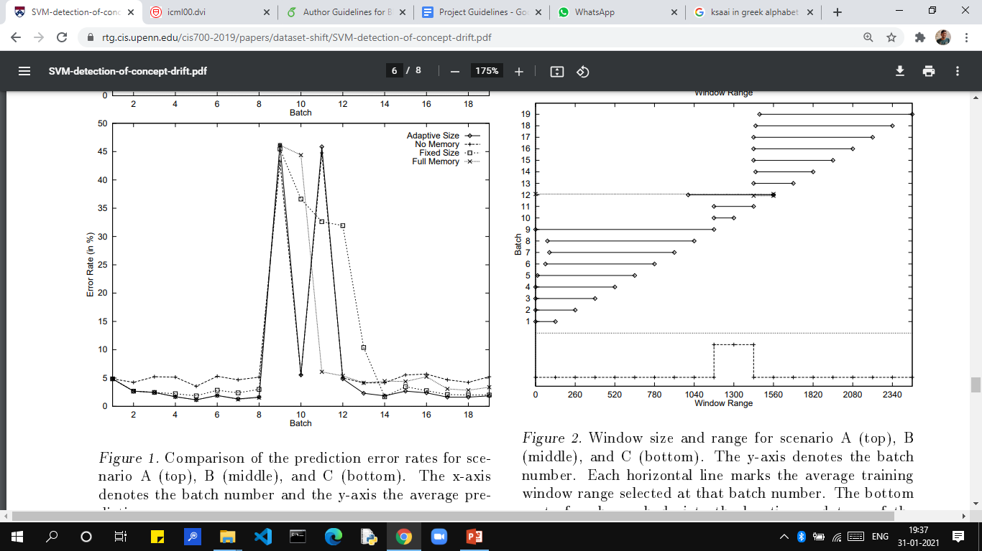

Slide 11
The Conclusion
We can see that the adaptive window size algorithm achieves a low average error rate on all three scenarios. Similarly, precision and recall are consistently high.
The method directly implements the goal of discarding irrelevant data with the aim of minimizing generalization error.
Unlike for the conventional heuristic approaches, this gives the new method a clear and simple theoretical motivation.
This method performs very well given the most recent examples are most similar to the new examples in the next batch i.e. t+1

Slide 12
Thank You

